Slide 1
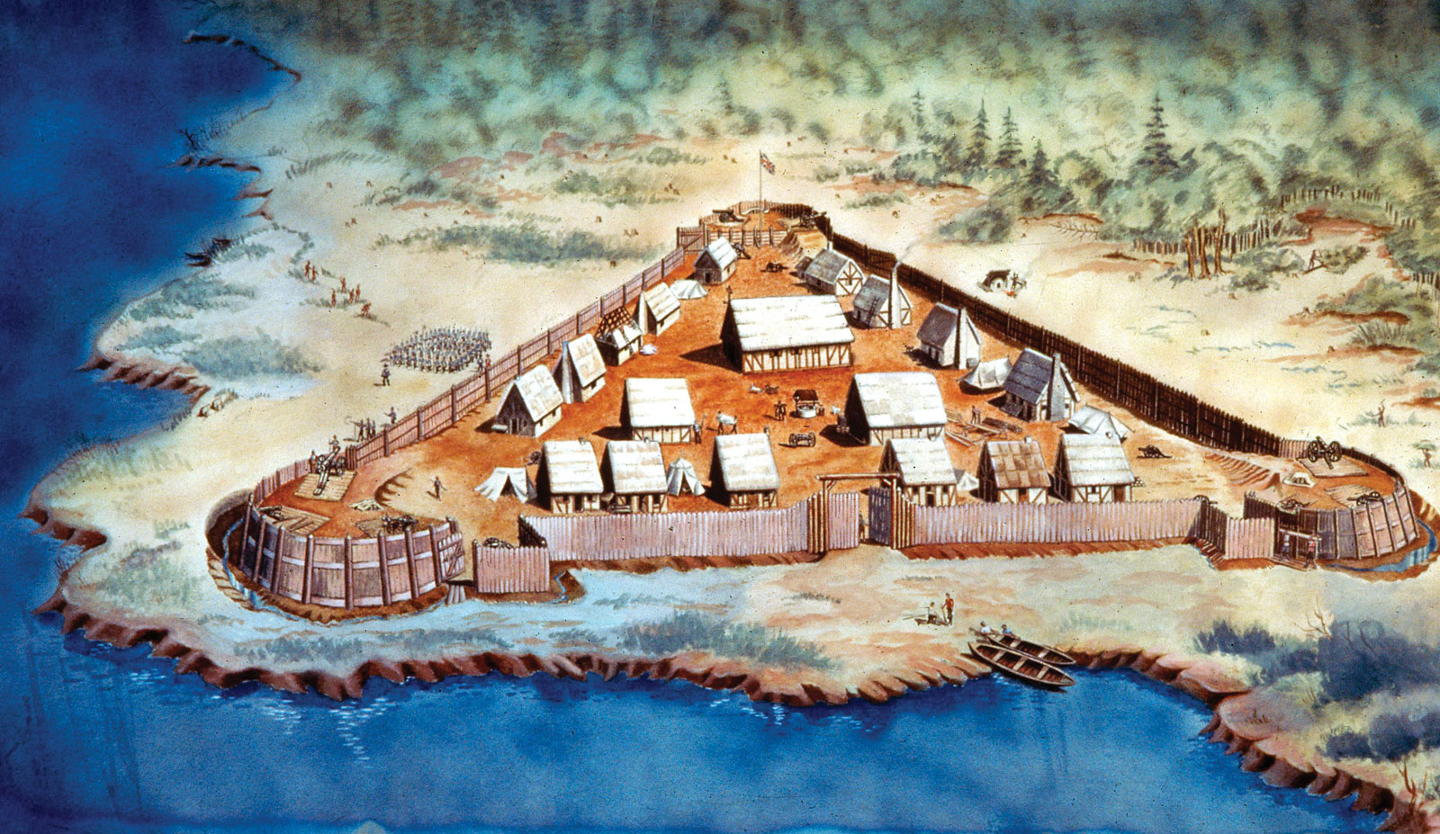
Early Colonization
Part 4- Jamestown

Slide 2
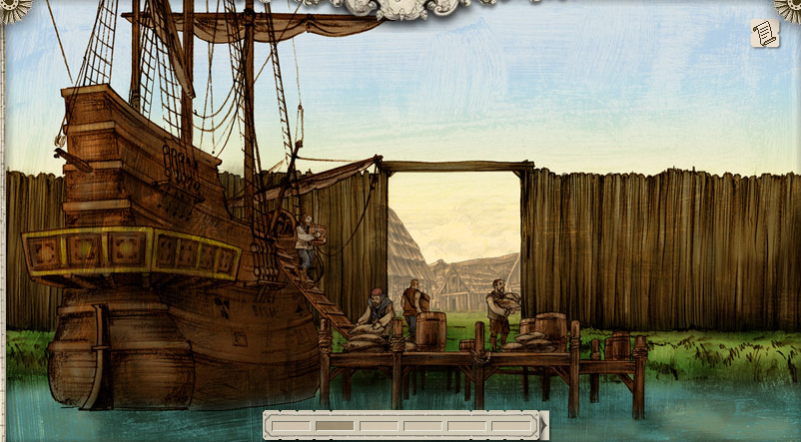
What kind of jobs do you think would be important for starting a new colony?
lukerosa@gmail.com

Slide 3
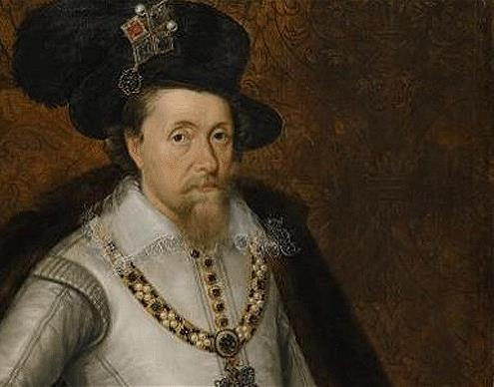
Grants a charter to the Virginia Company in 1606 to settle & civilize America
Wants to prevent Spanish advancements in the New World & find a Northern passage to Asia
Notes:
James I (also known as James VI of Scotland) became King of England and Ireland as James I from the union of the Scottish and English crowns in March 1603. He ruled until his death in 1625. He famously survived the Gunpowder Plot in 1605 when Guy Fawkes was captured attempting to blow up Parliament. Fawkes and his co-conspirators planned to assassinate King James and restore a Catholic monarch to the throne. Catholic Spain was an arch rival.

Slide 4
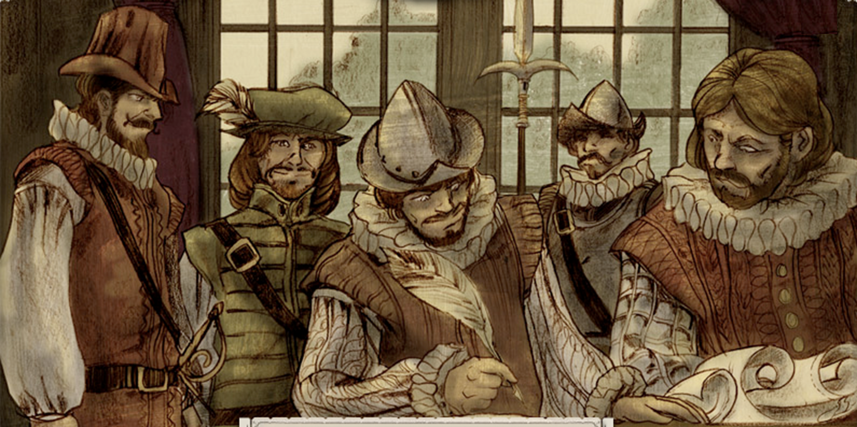
Joint stock company
Group of wealthy investors are shareholders
Plan to establish settlements in America for a profit
Notes:
A joint-stock company is a business in which shares of the company's stock can be bought and sold by shareholders. Each shareholder owns a piece of the company through the number of shares they own. The shares of each member can be purchased, sold, and transferred without the consent of other members. If the company makes money, the wealth goes to the shareholders. A single share of stock in the Virginia Company cost 12 pounds 10 shillings, the equivalent of more than 6 months' wages for an ordinary working man.

Slide 5
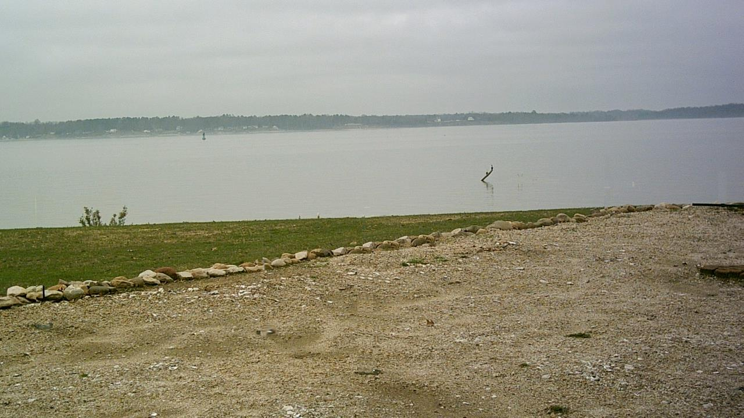
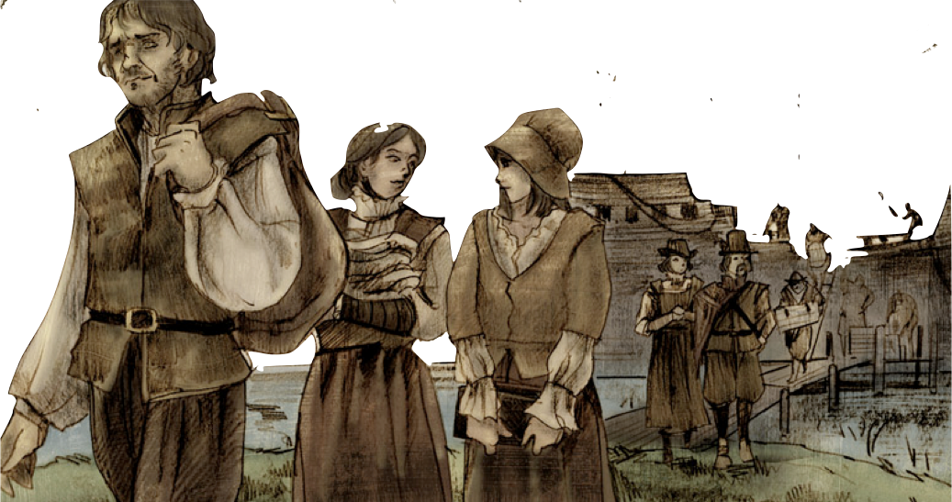
Sought economic opportunities
Expected wealth from gold & minerals
Notes:
The main backers of the company led an extensive publicity campaign, with pamphlets, plays, sermons and broadsides throughout England to raise interest. Volunteer laborers agreed to sign up as indentured servants. In exchange for 7 years of labor for the company, the company provided passage, food, protection, and land ownership (if the worker survived). There were many poor people in England at the time who were excited at this opportunity.

Slide 6
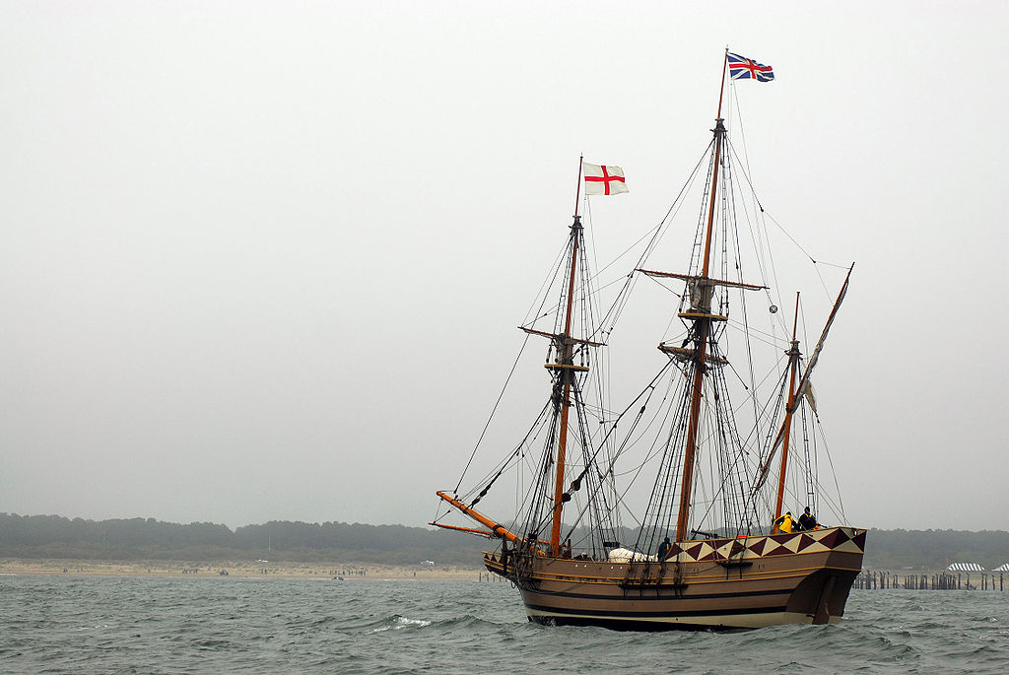
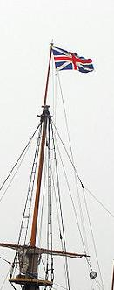
In December 1606, 105 settlers & entrepreneurs set off for America
Arrive in Virginia in April 1607
Edward Maria Wingfield elected president of governing council & selects the island location
Notes:
In December 1606, the Virginia Company's three ships, containing 105 men and boys as passengers and 39 crew members, set sail from Blackwall, London and made landfall on April 16, 1607, at the southern edge of the mouth of what they named the James River on the Chesapeake Bay. They named this shore as Cape Henry. They were attacked by Native Americans, and the settlers moved north. On May 14, 1607, these first settlers selected the site of Jamestown Island, further upriver and on the northern shore, as the place to build their fort.

Slide 7
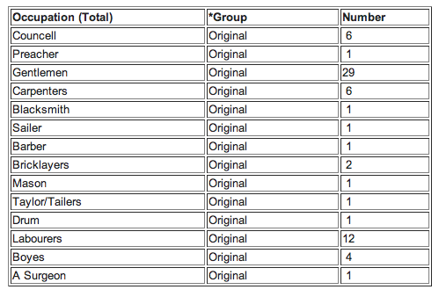
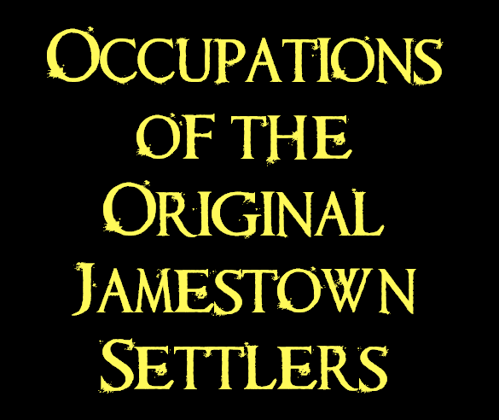
Notes:
Here we discuss the balance of laborers to “gentlemen” and whether or not they were prepared for the rigors of life in the wilderness. The settlers were disappointed that gold did not wash up on the beach and gems did not grow in the trees (as some were led to believe).

Slide 8
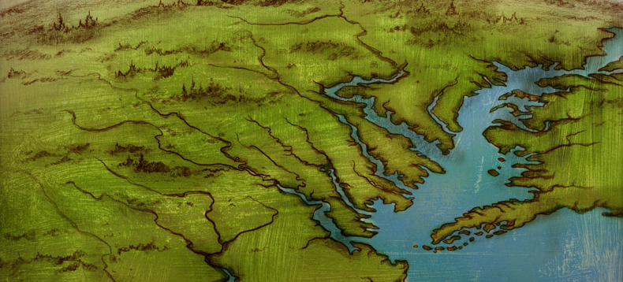
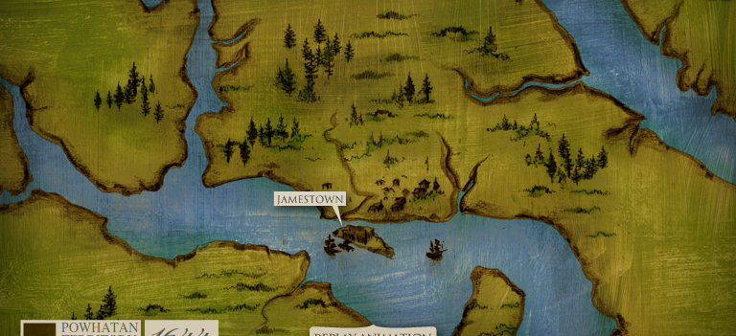
Far enough inland to hide from the Spanish
Deep water anchor for the ships
Swamp and river offers protection from local Native Americans
Notes:
Jamestown was located as close to the Atlantic Ocean as the initial colonial leaders thought was safe, rather than as far inland as ships could go, in order to balance military security with the logistics of getting back and forth to England. The site was in a secure place, where Spanish ships could not fire point blank into the fort.

Slide 9
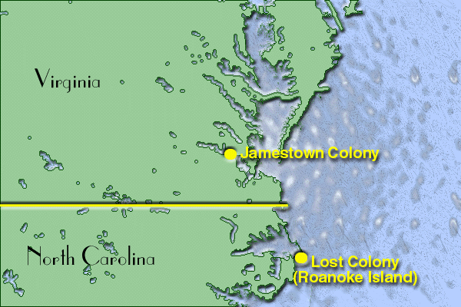

Slide 10
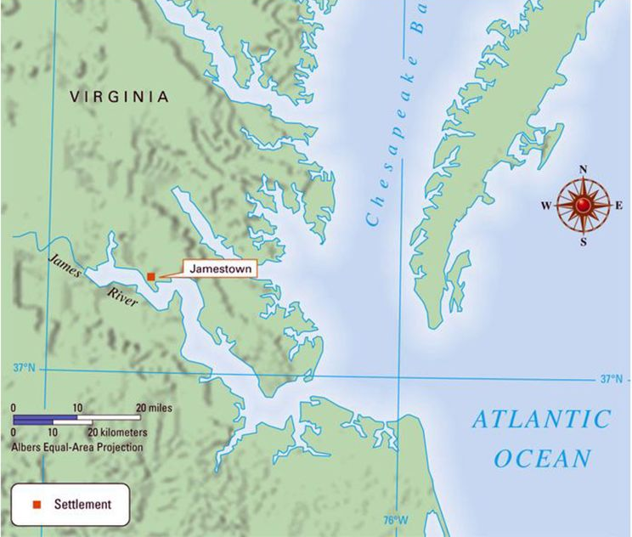

Slide 11
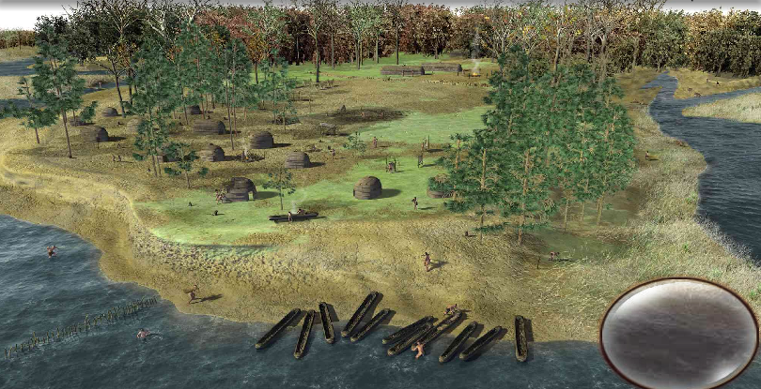
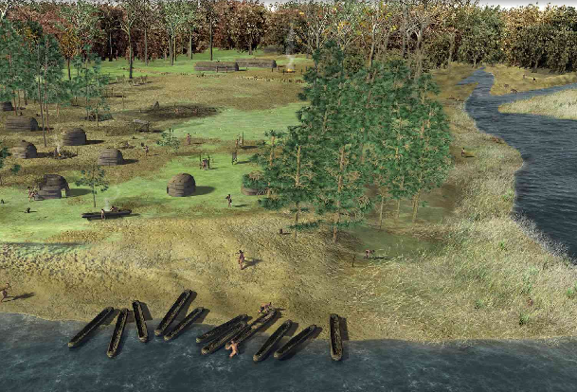
About 14,000 Powhatan Indians lived in the Virginia area
Chief Powhatan’s daughter was the famous Pocahontas
Notes:
The Powhatan were a confederacy of at least 30 Algonquian-speaking tribes that occupied most of the eastern shore of Chesapeake Bay. The confederacy had been formed by Chief Powhatan shortly before the settlement of Jamestown. The tribes of the confederacy provided mutual military support and paid taxes to Powhatan in the form of food, pelts, copper, and pearls.
Powhatan (also called Wahunsenacah) was father of Pocahontas. In the Algonquian language, his title as emperor was mamanatowick, and his territory was known as Tsenacommacah.

Slide 12
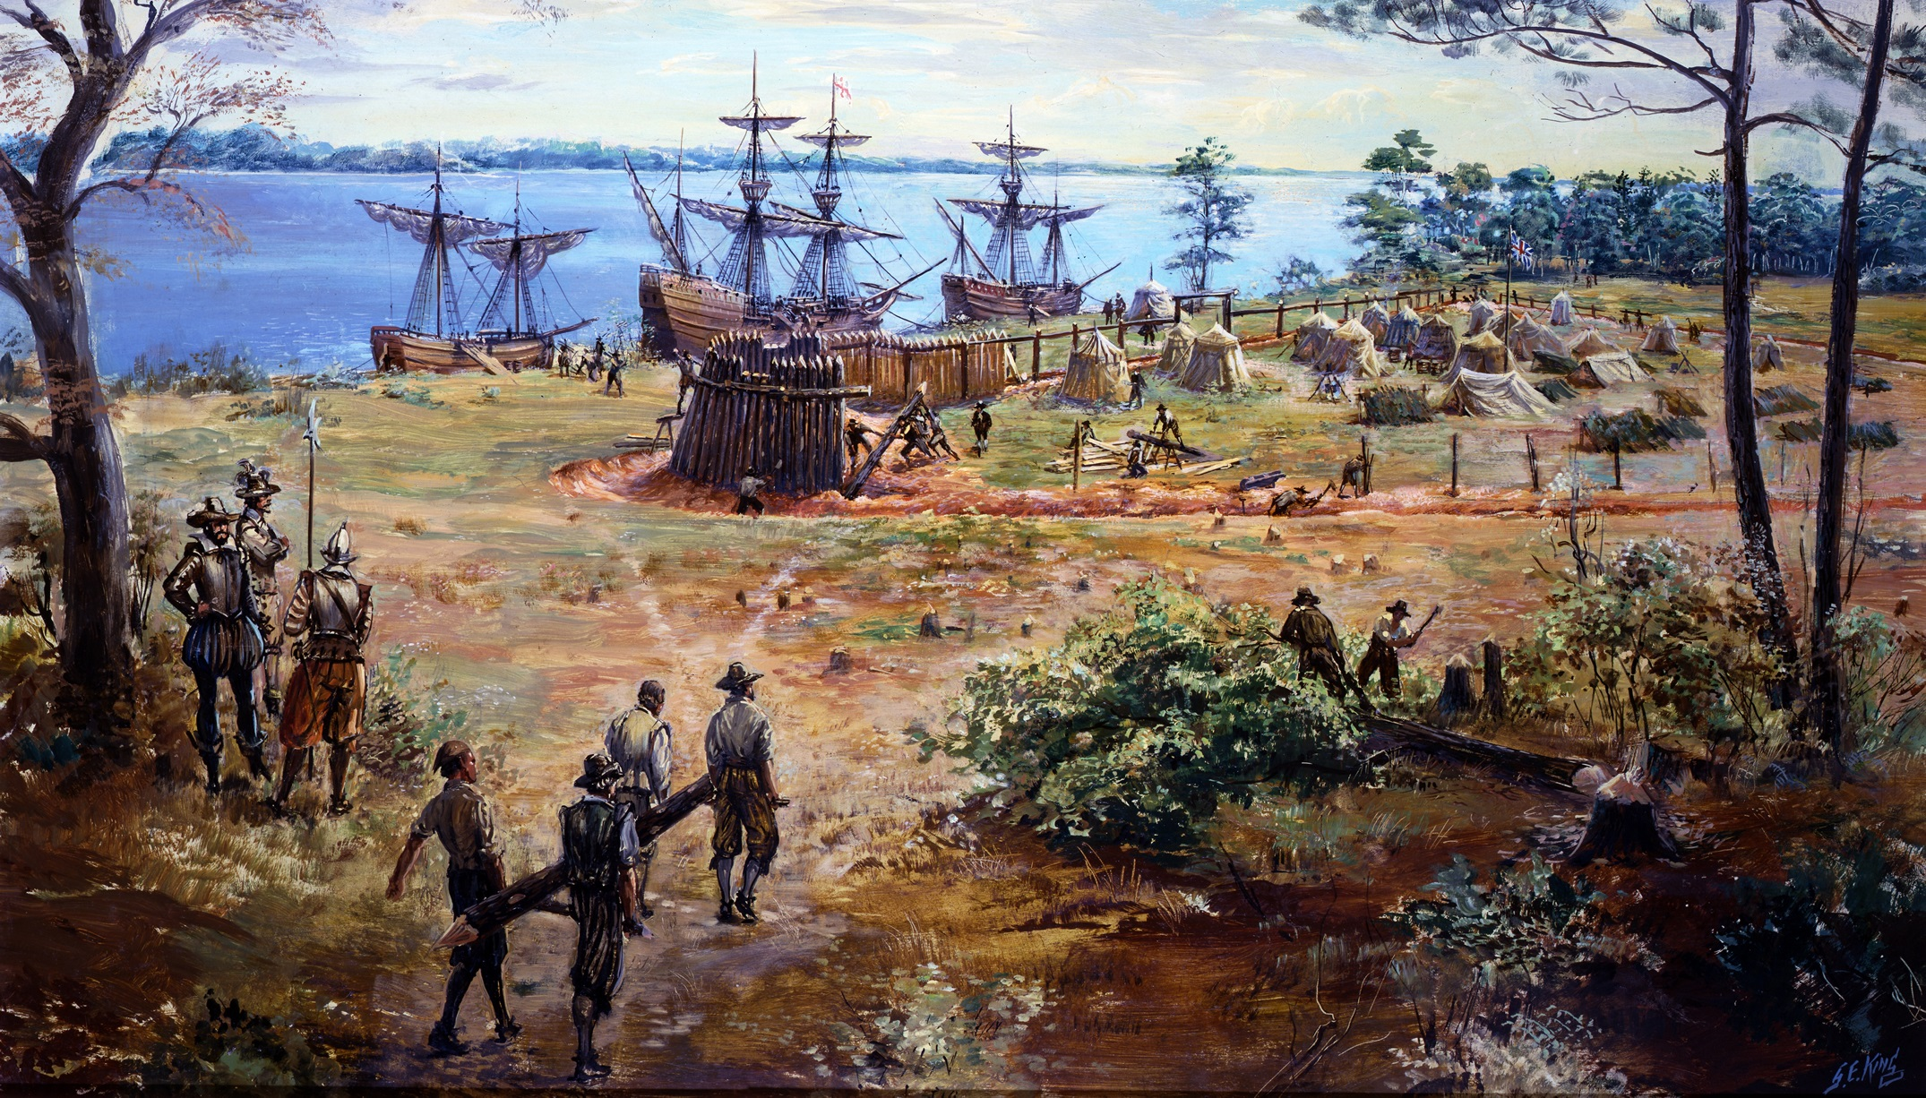
Notes:
The fort was built close to the deep-water anchor for the ships, so colonists could escape quickly if attacked. It was 3 sided for defense and built from lumber they cut down as their first endeavor.

Slide 13
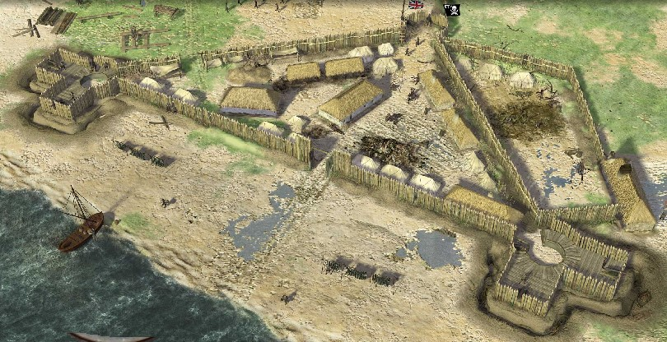
Notes:
Within the three-sided fort erected on the banks of the James, the settlers quickly discovered that they were, first and foremost, employees of the Virginia Company of London, following instructions of the men appointed by the company to rule them. In exchange, the laborers were armed, and received clothes and food from the common store. After seven years, they were to receive land of their own. The gentlemen, who provided their own armor and weapons, were to be paid in land, dividends or additional shares of stock.

Slide 14
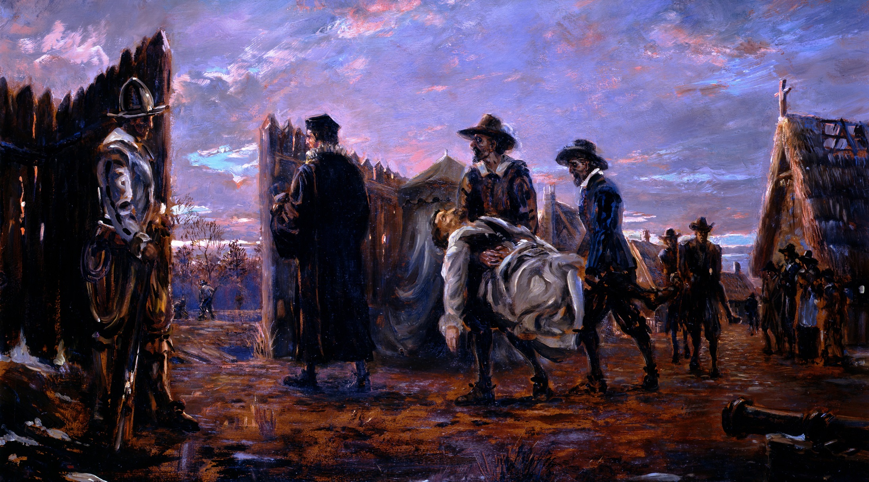
Many of the settlers unaccustomed to work
Didn’t plan for such harsh winters
Too much time spent searching for gold & minerals
Notes:
The winter of 1609-1610 in Jamestown is referred to as the "starving time." Disease, violence, drought, a meager harvest followed by a harsh winter, and poor drinking water left most colonists dead that winter. As the food stocks ran out, the settlers ate the colony's animals—horses, dogs, and cats—and then turned to eating rats, mice, and shoe leather. In their desperation, some practiced cannibalism.

Slide 15
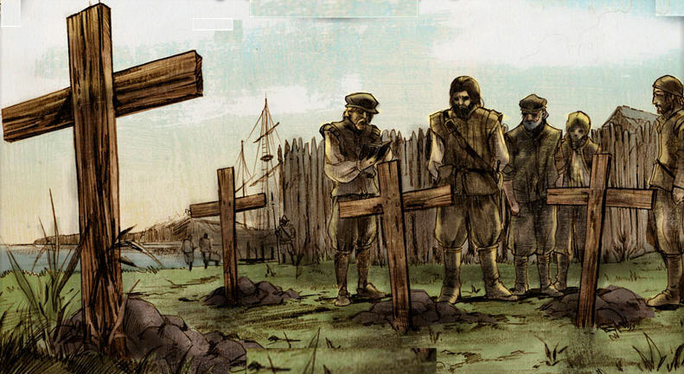
Disease from the infected river
Hunger from not planting crops
Attacks by local Native Americans
lukerosa@gmail.com
Notes:
The winter of 1609-1610 in Jamestown is referred to as the "starving time." Disease, violence, drought, a meager harvest followed by a harsh winter, and poor drinking water left most colonists dead that winter. As the food stocks ran out, the settlers ate the colony's animals—horses, dogs, and cats—and then turned to eating rats, mice, and shoe leather. In their desperation, some practiced cannibalism.

Slide 16
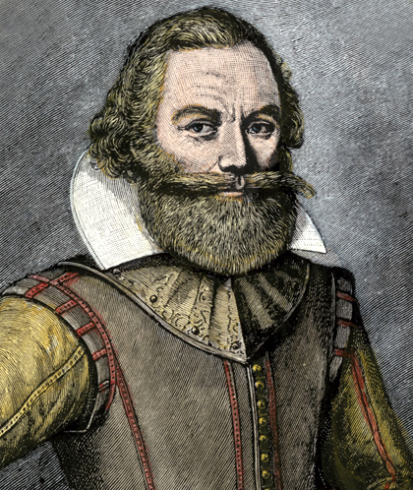
Supposedly saved by Pocahontas
Takes leadership of the colony
“He that will not work, shall not eat.”
lukerosa@gmail.com
Notes:
Smith gained the respect of the colonists and the Powhatan as well. He forced everyone to work and set up trade with the Powhatan after he helped to improve relations with them. Back in England the publication of John Smith's books of his adventures in Virginia sparked a resurgence of interest in the colony. This helped lead to new interest and investment in the Virginia Company. There was also a moral call in England by clergymen and others for support for the stranded colonists.

Slide 17
Only about 60 colonists left when 2 ships arrive from England with resources and new settlers
Notes:
On June 7, 1610, the survivors boarded ships, abandoned the colony site, and sailed towards the Chesapeake Bay. There, another supply convoy with new supplies, headed by newly appointed governor Francis West, intercepted them on the lower James River and returned them to Jamestown. With the new supplies, Captain Smith felt the colony was sufficiently reinforced to engage the Powhatan directly through diplomacy.

Slide 18
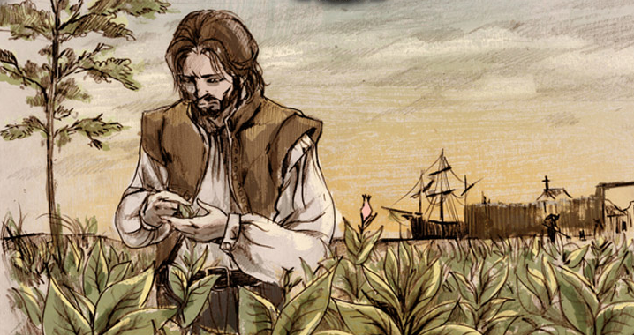
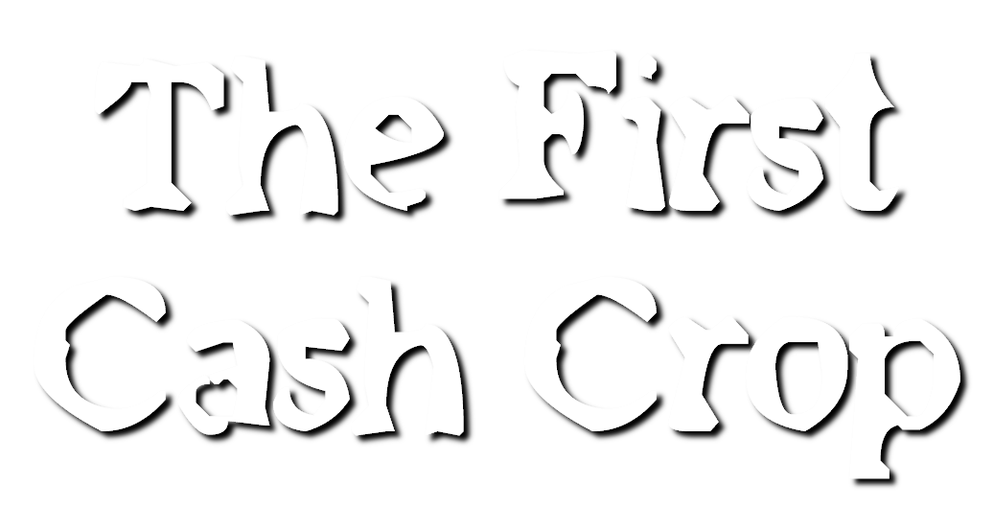
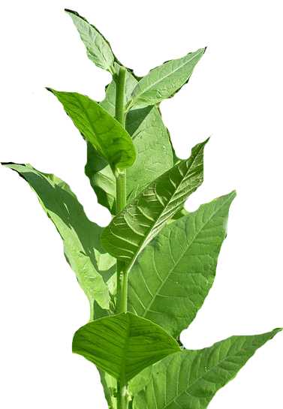
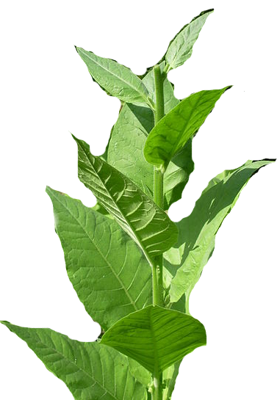
Notes:
A young Englishman named John Rolfe arrived at Jamestown in May 1610. His wife and young daughter had died during the journey to America and delay in Bermuda. He knew that the native tobacco from Virginia was not liked in England. However, he brought with him some seeds for several new strains of tobacco to experiment with.

Slide 19
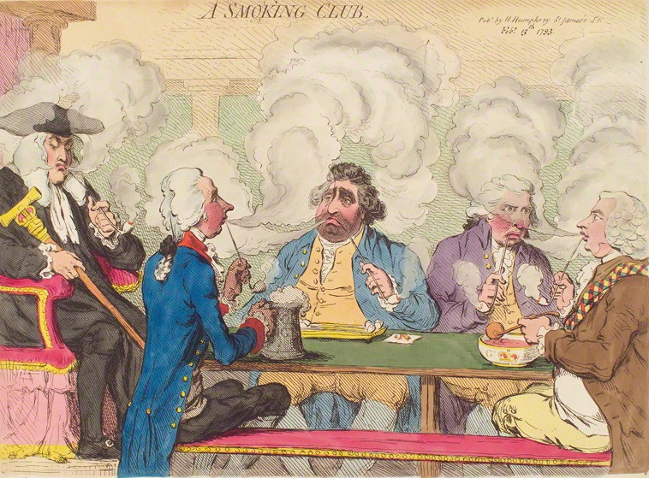
1612 - John Rolfe creates a smoother breed of tobacco
Becomes very popular in England
Notes:
Using the sweeter strains, Rolfe is credited with being the first to commercially cultivate Nicotiana tabacum tobacco plants in North America in 1611; the export of this sweeter tobacco beginning in 1612 helped turn the Virginia Colony into a profitable venture. Soon, Rolfe and others were exporting substantial quantities of the new cash crop. A cash crop is one grown specifically for sale.

Slide 20
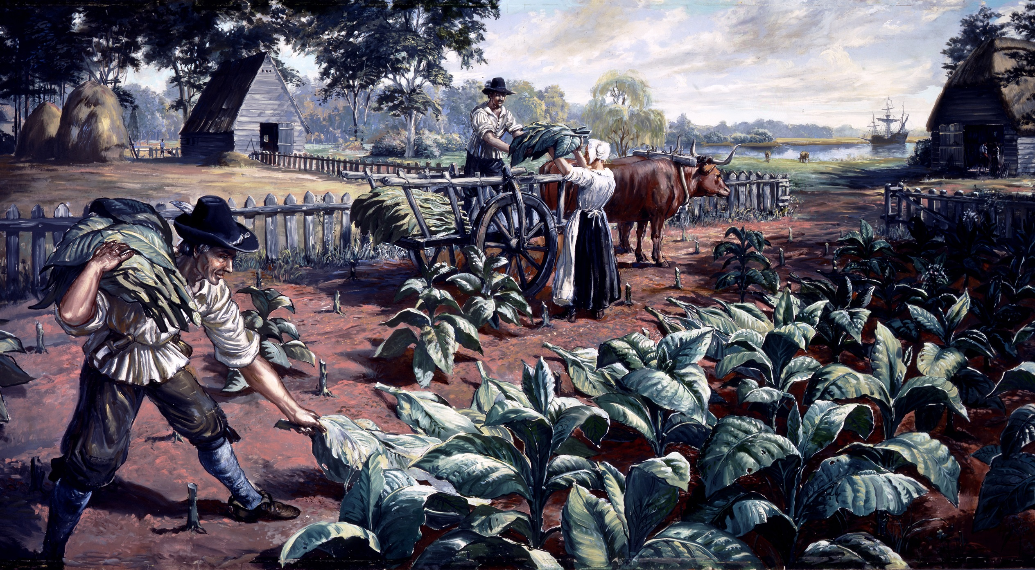
Tobacco becomes a cash crop colonists can sell
John Rolfe marries Pocahontas which helps bring peace to English & Native Americans
Notes:
John Rolfe became prominent and wealthy, and soon held an interest in several plantations. Pocahontas was captured and held for ransom by English colonists during hostilities in 1613. During her captivity, she was encouraged to convert to Christianity. She married Rolfe in April 1614 at the age of about 17 or 18, and she bore their son Thomas Rolfe in January 1615. This began a short period of truce between the English and the Powhatan Confederacy.

Slide 21
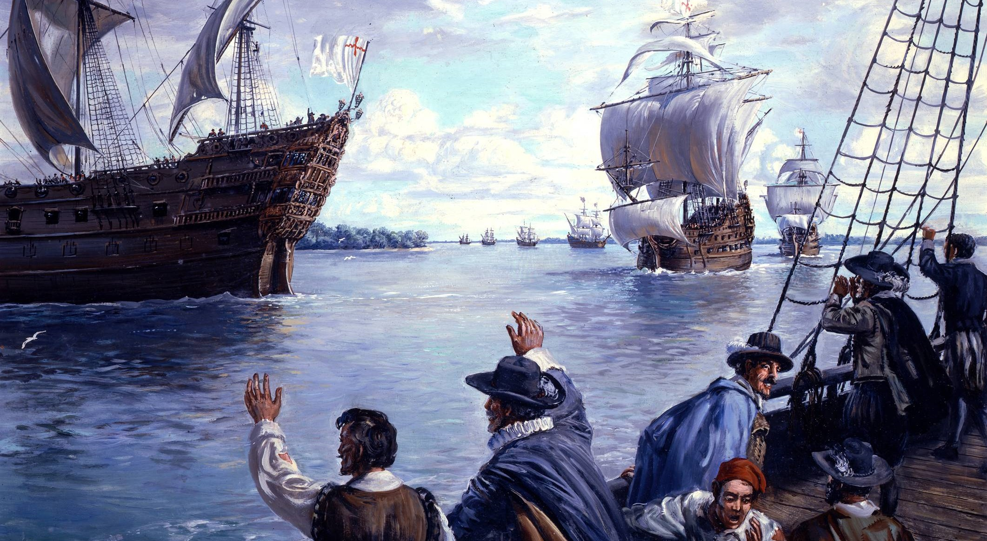
Growing tobacco is very labor-intensive & more colonists are needed to work
Indentured Servants arrive - poor English who agree to work for a number of years in return for their passage
Notes:
Growing tobacco was profitable for planters, but it required a large amount of land and a considerable labor force. The tobacco growing process was a year-round occupation. First, land was cleared for fields. Seeds were started in January. Harvesting, curing and packing of the leaves occurred in late summer and fall. With a small population in Virginia, planters sought workers from England, often paying their passage to the colony. The system of indentured servitude grew out of the traditional English system of apprenticeship.

Slide 22
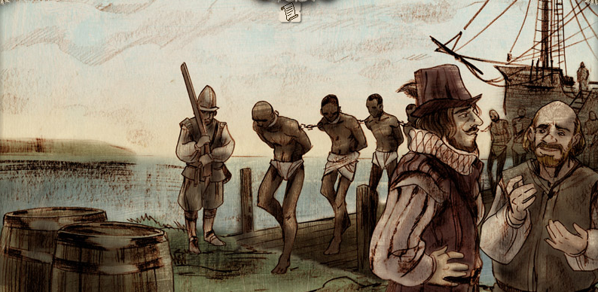
Eventually even more labor is needed to keep up with demand
First Africans brought to Jamestown in 1619 & institution of slavery begins
Notes:
On August 20, 1619, “20 and odd” Angolans, kidnapped by the Portuguese, arrive in the British colony of Virginia and are then bought by English colonists. They were originally kidnapped by Portuguese colonial forces in Africa. There, they were forced aboard the ship San Juan Bautista, which set sail for Veracruz in the colony of New Spain. As it approached its destination, the ship was attacked by two privateer ships, the White Lion and the Treasurer. Crews from the two ships kidnapped up to 60 of the Bautista’s enslaved people. It was the White Lion which docked at Virginia Colony's Point Comfort and traded some of the prisoners for food on August 20, 1619.

Slide 23
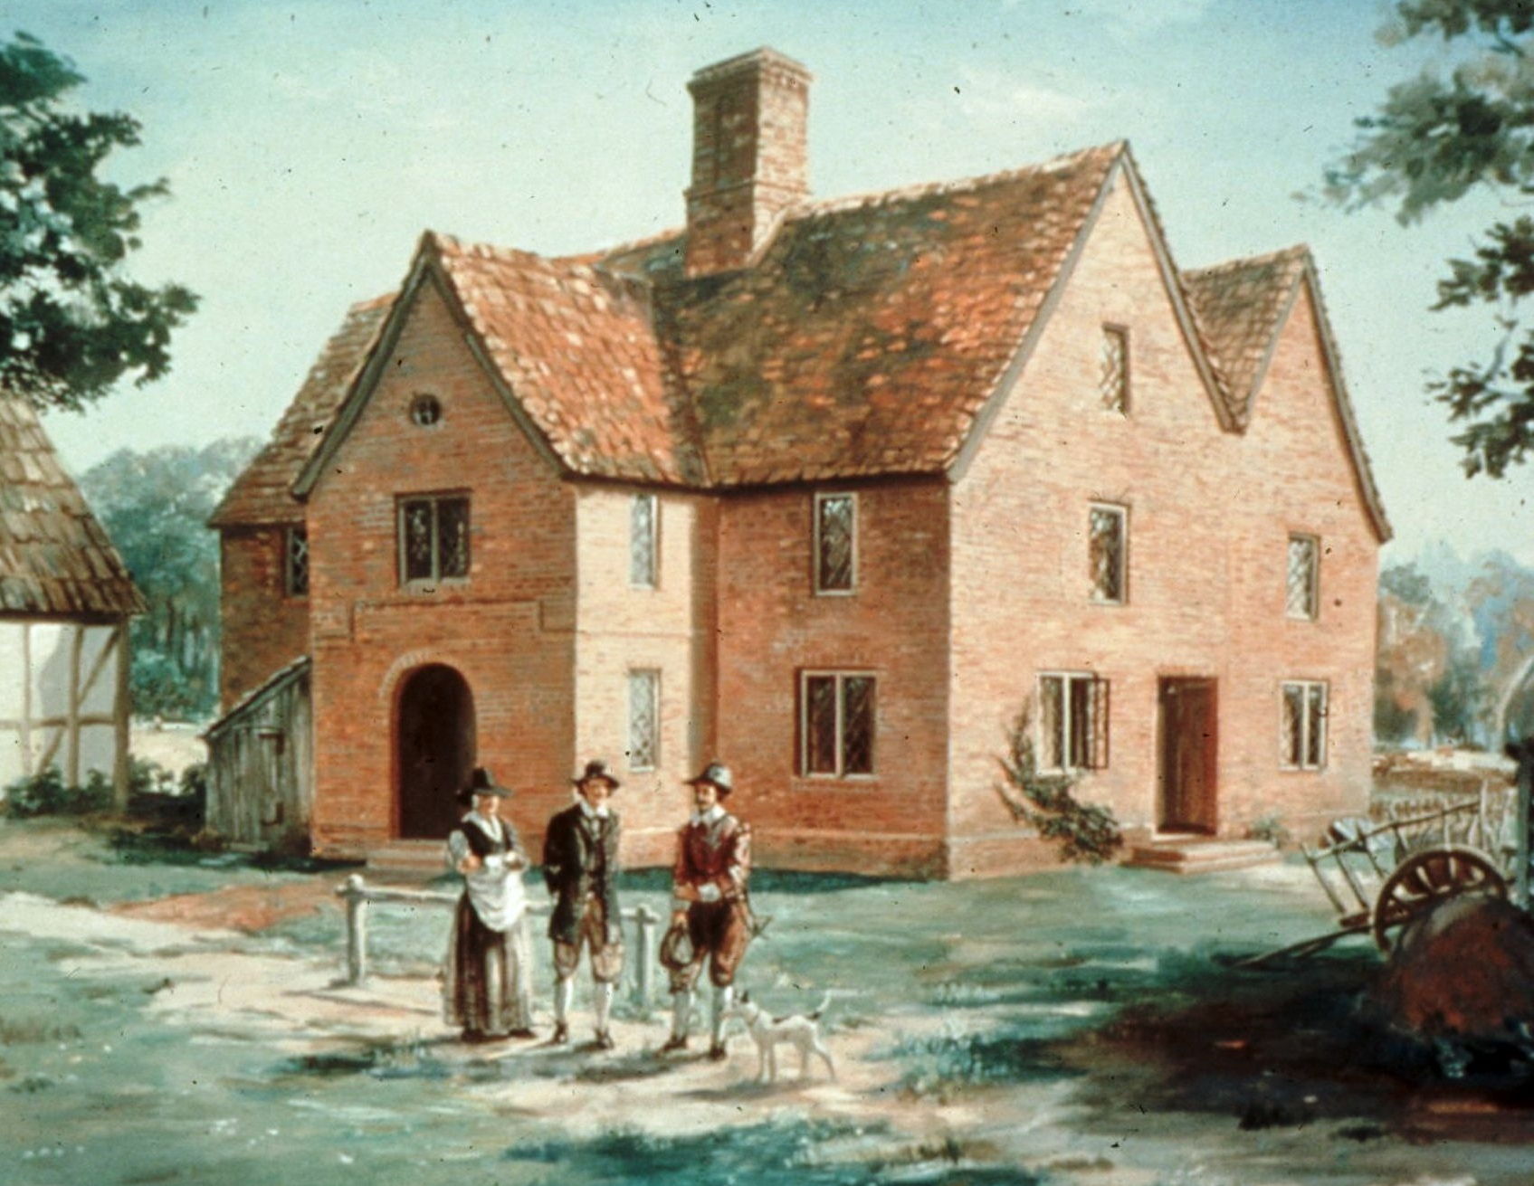
Established in 1619 so colonists could make their own laws
Becomes the first representative government in America
lukerosa@gmail.com
Notes:
With its origin in the first meeting of the Virginia General Assembly at Jamestown in July 1619, the House of Burgesses was the first democratically-elected legislative body in the British American colonies. It was responsible for passing laws and maintaining order in the Jamestown Colony of Virginia and the other settlements that had grown up around it.

Slide 24
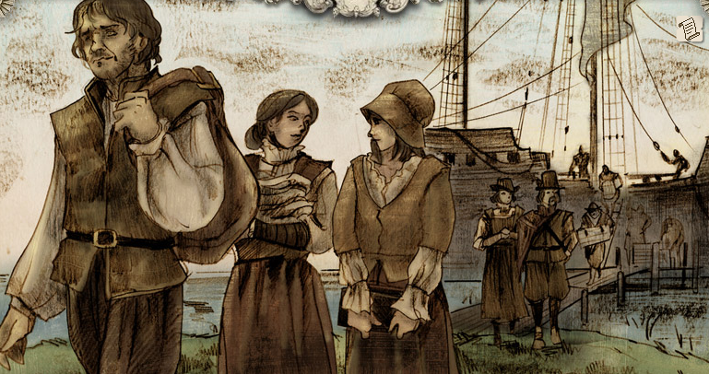
In 1620, about 90 women arrive from England
Allows settlers to establish families & make Jamestown more of a permanent colony
Notes:
In 1619, the Jamestown consisted mostly of single men looking to get rich. For the Virginia Company, this presented a problem: how to keep it growing when few single English women wanted to venture to the struggling colony? The solution it came up with was to pay women’s passage to Jamestown so they could marry its bachelors. The Virginia Company advertised that if English women agreed to come to Jamestown in search of a husband, the company would loan them clothing, transportation and a plot of land. In Jamestown, they could have their pick of wealthy bachelors. The Jamestown brides program attracted 90 women who came over in 1620, and another 56 who came over in late 1621 and early 1622. Most of the women who sailed to Jamestown through the program married a man within three months.

Slide 25
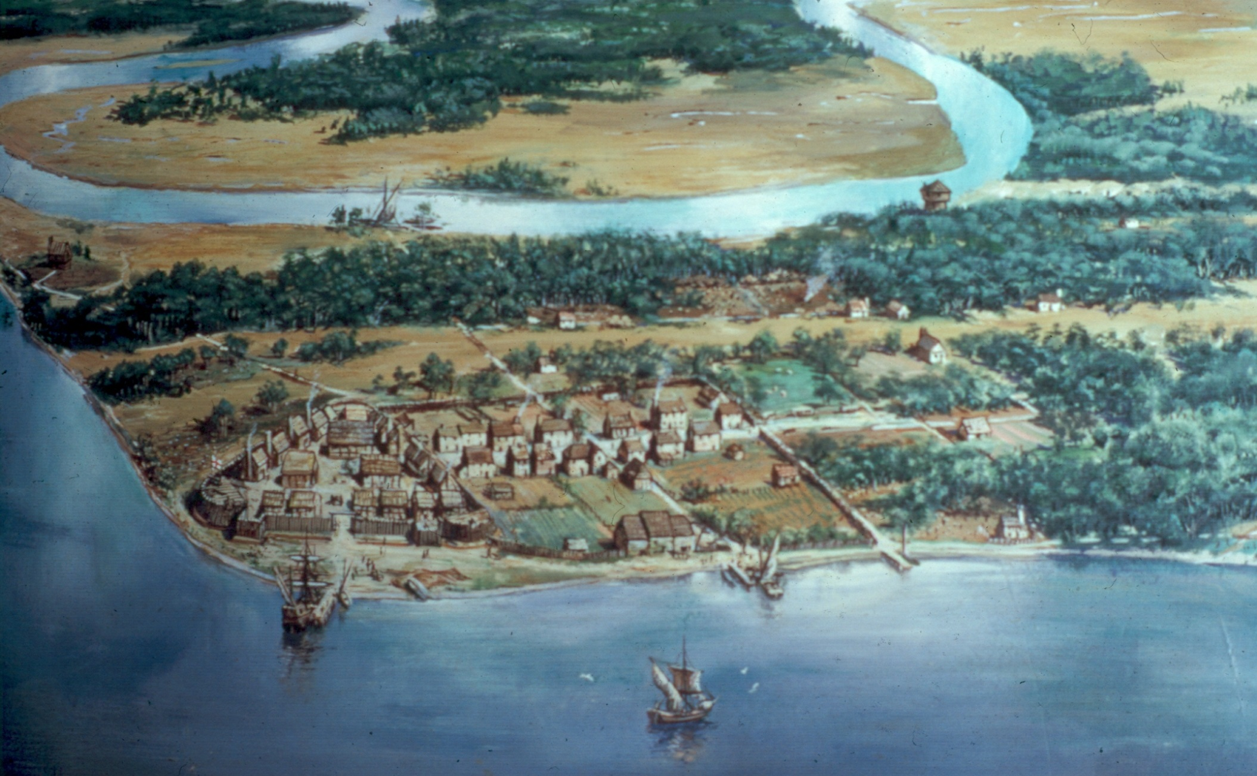
Notes:
Of the 6,000 people who came to the settlement between 1608 and 1624, only 3,400 survived. In 1624, King James revoked the Virginia Company's charter, and Virginia became a royal colony. However, the colony continued to grow. Ten years later, in 1634, by order of King Charles I, the colony was divided into the original eight shires of Virginia (or counties), in a fashion similar to that practiced in England. Jamestown was now located in James City Shire, soon renamed the "County of James City", now known as James City County, the nation's oldest county.

